Slide 1
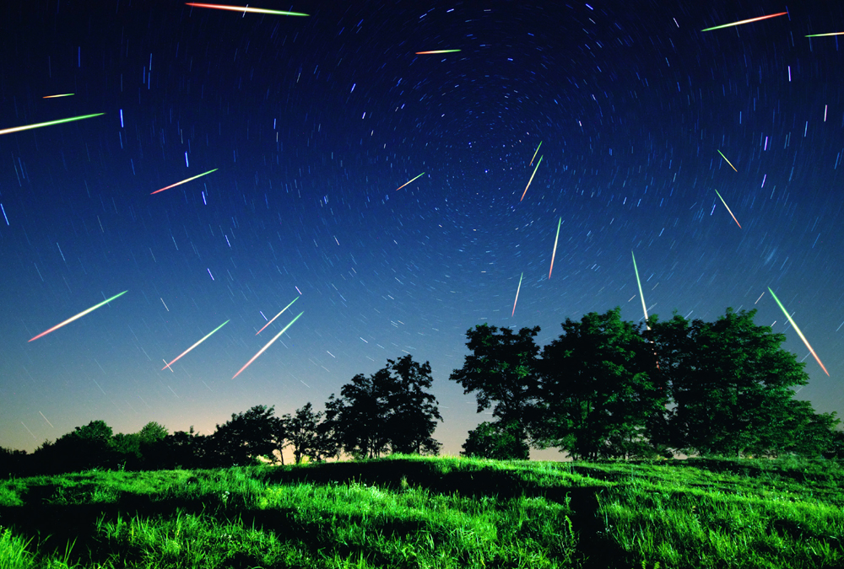
Meteor Observing

Slide 2
The Last 200 Years of Meteor Storms

Slide 3
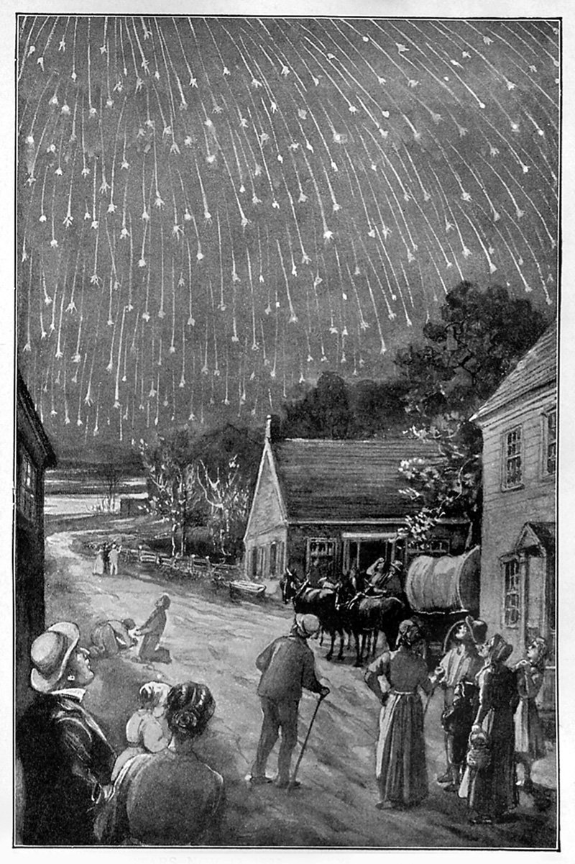
Leonids
1833 – “Rate beyond counting”
1866-1868 – 1,000/Hr
Comet Temple-Tuttle

Slide 4
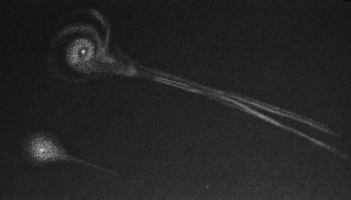
Comet Biela 1846, 1852
Andromedids
1872 – 7,000/Hr
1885 – 6,000/Hr

Slide 5
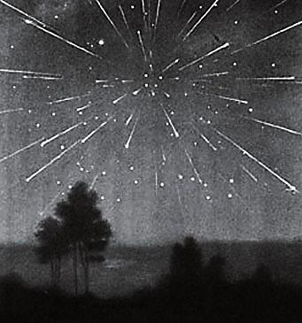
Draconids – Comet Giacobini Zinner
1933 – 6,000/Hr +80 days
1946 – 6,000/Hr +15 days

Slide 6
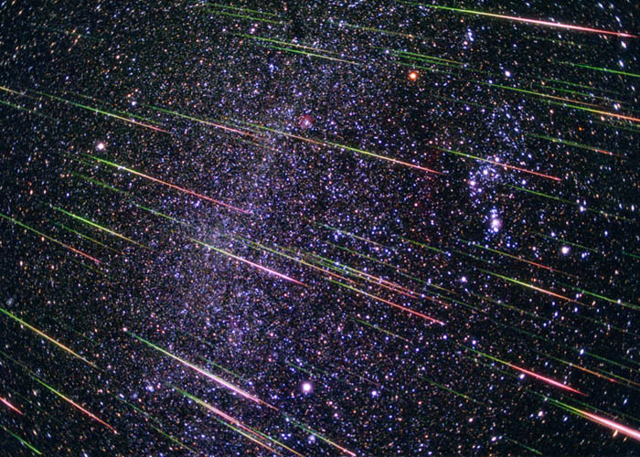
Leonids
1966 – 140,000/Hr
1999 – ZHR 3,000
2001 – ZHR 1,000 & 2,000
2002 – ZHR 2,000 & 2,500

Slide 7
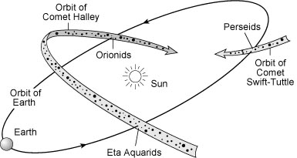
Where Do Meteors Showers Come From?
Solar Long.

Slide 8
Meteor Shower Characteristics
Zenithal Hourly Rate (ZHR)
    Rate w/ shower at zenith and limiting magnitude of 6.5
Radiant
Speed
Duration (Time above Quarter Max)
Periodicity
Time of Peak
Phase of the Moon

Slide 9
What are the Big 3 Meteor Showers?

Slide 10
Annual Meteor Showers
Perseids – Aug 12,13 ZHR 100 Fast
Epsilon Perseids – Sep 9 ZHR 5 Fast
Draconids – Oct 8,9 ZHR 0-Storm Very Slow
Orionids – Oct 21 ZHR 20 Very Fast
N. Taurids – Nov 12 ZHR 5 Med Slow
Leonids – Nov 17 ZHR 10-Storm Very Fast
Geminids – Dec 15 ZHR 120 Med
Ursids – Dec 22 ZHR 10 Med
Quadrantids – Jan 3,4 ZHR 120 Med Fast
Lyrids – Apr 21,22 ZHR 18 – 90 Med Fast
eta-Aquariids – May 6 ZHR 55 Very Fast
(Surprise 135)
June Boötids – Jun 27,28 ZHR 0-100+ Very Slow
Antihelion Source ZHR 2-5

Slide 11
Meteor Observing
Look up
The darker the better
Reclining chair or blanket – sleeping bag
Rate picks up after midnight as Earth turns into direction of orbit
Look near radiant
If radiant is very low may see long grazing meteors
Trail – Color – Explosions – Fragments
Sporadics

Slide 12
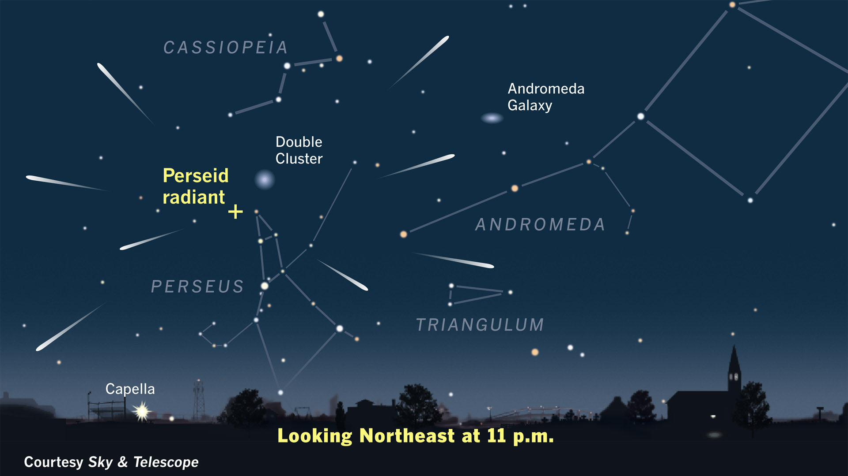

Slide 13
Recording Meteors
Count
Plotting
International Meteor Organization (IMO)
  imo.net – lots of info
  Limiting Magnitude – Charts
  Record time and magnitude of each meteor
  Record start & end times
  Report form – counts & magnitude distribution
  Live updates on website

Slide 14
Imaging and Detecting Meteors
Fast, wide angle lens
Pictures or Video
Fixed – Star trails & meteors
Tracking – Can stack frames w/ meteors to get multiple meteors in 1 picture
Automated video meteor detection – e.g. IMO Video Meteor Network
*Latest Thing* - Video through a telescope to catch lunar impacts

Slide 15
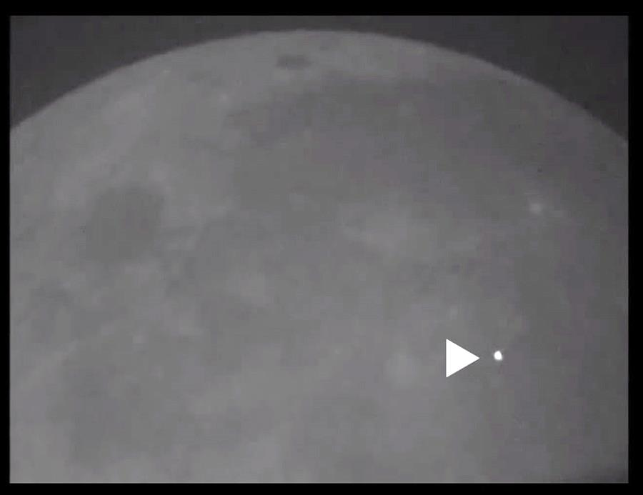
March 17, 2013 – 4th Mag – Brightest Ever

Slide 16
Predicting Meteor Showers
Solar Longitude of Node of Comet’s Orbit
Extrapolation of historical data

Slide 17
Predicting Meteor Showers
Solar Longitude of Node of Comet’s Orbit
Extrapolation of historical data
Computer simulation of comet debris

Slide 18
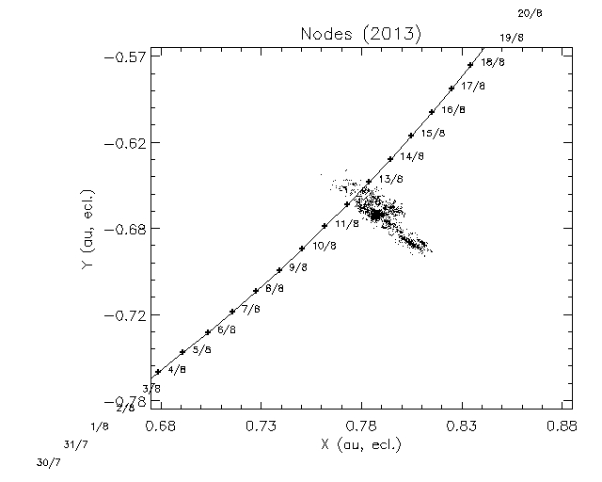
Perseids 2013

Slide 19
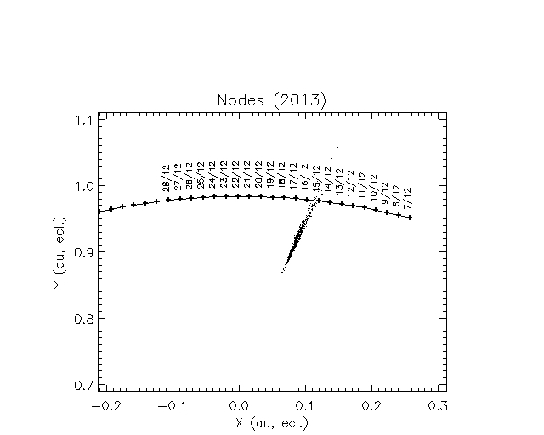
Geminids 2013

Slide 20
Future Meteor Shower Predictions
Shower/Radiant | Date/Time ET | ZHR | Moon
Comet ISON | Jan 12, 2014 | 0? | Full
Camelopardalis 209P/LINEAR (2004 CB) | May 24, 2014 3:40 | 100-400 Maybe 1,000 | Crescent
Draconids | Oct 9, 2018 19-20 | 10-40 | New
Tau Herculids 73P\Schwassmann-Wachmann 3 | May 31, 2022 1:15 | 10,000–100,000 | New
Perseids | Aug 12, 2028 1:30 | 1,000 | Last Q
Leonids | Nov 19, 2034 0-1 | 100+ Bright | First Q
Leonids | Nov 20, 2035 1:06 | 200+ Bright | Wane G
Leonids | Nov 20, 2037 | 800 | Full
June Bootids | Jun 22, 2045 6:26 | 1,000 – 7,000 | First Q

Slide 21
End

Slide 22
Max Km/s ZHR
Quadrantids (QUA) Jan 03 41 120
Centaurids (ACE) Feb 08 56 6
Normids (GNO) Mar 14 56 6
Lyrids (LYR) Apr 22 49 18
Puppids (PPU) Apr 23 18 Var
Aquariids (ETA) May 06 66 55∗
Lyrids (ELY) May 08 43 3
June Bootids (JBO) Jun 27 18 Var
Piscis Austrinids (PAU) Jul 28 35 5
South. -Aquariids (SDA) Jul 30 41 16
Capricornids (CAP) Jul 30 23 5
Perseids (PER) Jul 17–Aug 24 Aug 12 140 .◦0 48◦ +58◦ 59 2.2 100
-Cygnids (KCG) Aug 03–Aug 25 Aug 17 145◦ 286◦ +59◦ 25 3.0 3
Aurigids (AUR) Aug 28–Sep 05 Sep 01 158 .◦6 91◦ +39◦ 66 2.5 6
Sept. "-Perseids (SPE) Sep 05–Sep 21 Sep 09 166 .◦7 48◦ +40◦ 64 3.0 5
Draconids (DRA) Oct 06–Oct 10 Oct 08 195 .◦4 262◦ +54◦ 20 2.6 Var
Southern Taurids (STA)∗ Sep 10–Nov 20 Oct 10 197◦ 32◦ +09◦ 27 2.3 5
-Aurigids (DAU) Oct 10–Oct 18 Oct 11 198◦ 84◦ +44◦ 64 3.0 2
Geminids (EGE) Oct 14–Oct 27 Oct 18 205◦ 102◦ +27◦ 70 3.0 3
Orionids (ORI) Oct 02–Nov 07 Oct 21 208◦ 95◦ +16◦ 66 2.5 20∗
Leonis Minorids (LMI) Oct 19–Oct 27 Oct 24 211◦ 162◦ +37◦ 62 3.0 2
Northern Taurids (NTA)∗ Oct 20–Dec 10 Nov 12 230◦ 58◦ +22◦ 29 2.3 5
Leonids (LEO)∗ Nov 06–Nov 30 Nov 17 235 .◦27 152◦ +22◦ 71 2.5 15∗
-Monocerotids (AMO) Nov 15–Nov 25 Nov 21 239 .◦32 117◦ +01◦ 65 2.4 Var
Phoenicids (PHO) Nov 28–Dec 09 Dec 06 254 .◦25 18◦ −53◦ 18 2.8 Var
Puppid/Velids (PUP) Dec 01–Dec 15 (Dec 07) (255◦) 123◦ −45◦ 40 2.9 10
Monocerotids (MON) Nov 27–Dec 17 Dec 09 257◦ 100◦ +08◦ 42 3.0 2
-Hydrids (HYD) Dec 03–Dec 15 Dec 12 260◦ 127◦ +02◦ 58 3.0 3
Geminids (GEM) Dec 04–Dec 17 Dec 14 262 .◦2 112◦ +33◦ 35 2.6 120
Comae Berenicids (COM) Dec 12–Dec 23 Dec 16 264◦ 175◦ +18◦ 65 3.0 3
Dec. LeonisMinorids (DLM)Dec 05–Feb 04 Dec 19 268◦ 161◦ +30◦ 64 3.0 5
Ursids (URS) Dec 17–Dec 26 Dec 22 270 .◦7 217◦ +76◦ 33 3.0 10

